Slide 1
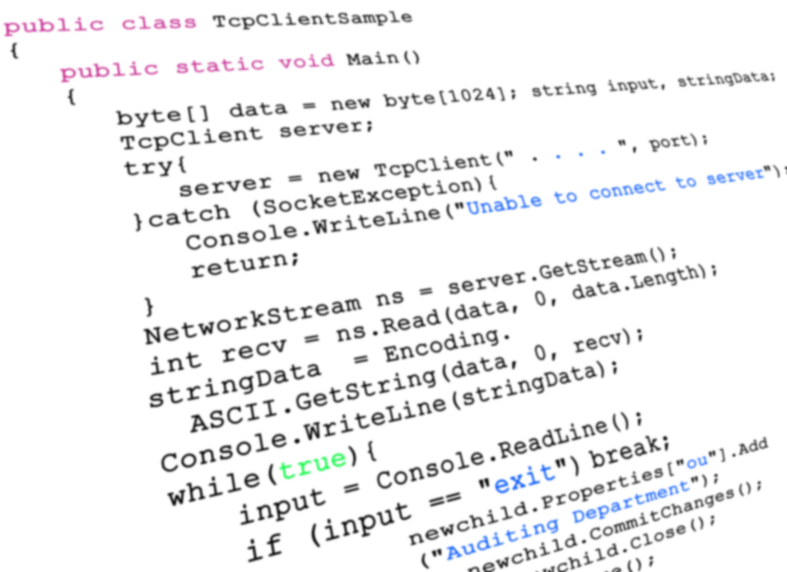
Python으로
IoT(Internet of Things),
Cognitive, Machine Learning
3종 셋트 활용하기
김영욱 Evangelist
Microsoft / DX / 부장
youngwook@outlook.com

Slide 2
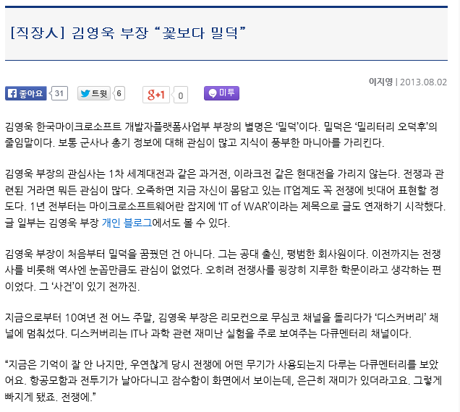



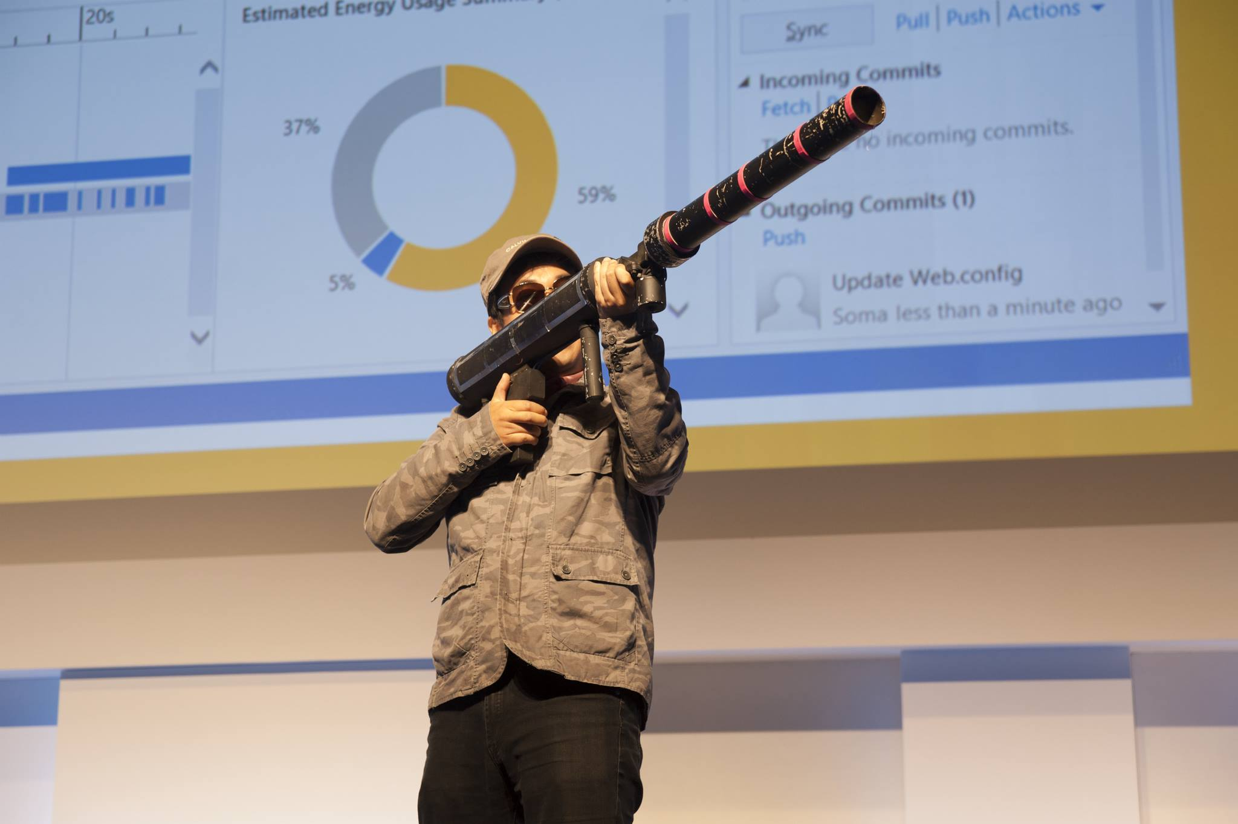

Slide 3


Slide 4


War of IT

Slide 5

https://github.com/KoreaEva/Python.git

Slide 6


Slide 7
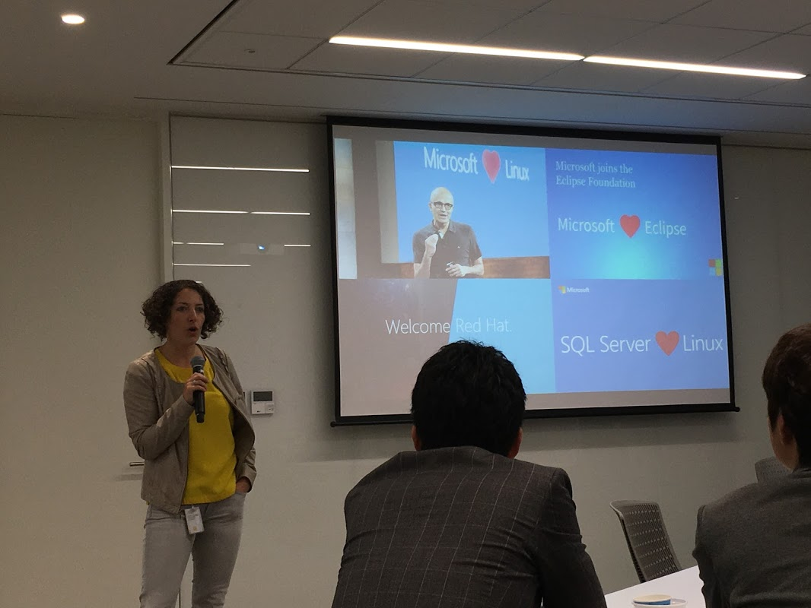
Microsoft
LOVE ♥

Slide 8
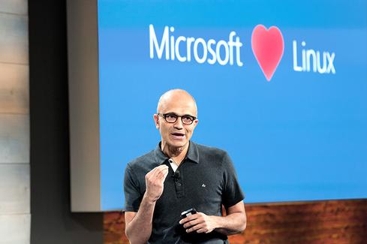
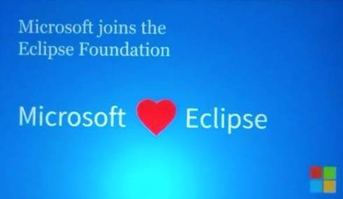



Slide 9
Microsoft ♥ Open Source

Slide 10









NTVS(Node.js Tools for Visual Studio)
RTVS(R Tools for Visual Studio)
PTVS(Python Tools for Visual Studio)
PHP Tools for Visual Studio
Visual C++ for Linux

Slide 11
Microsoft is Open Source

Slide 12
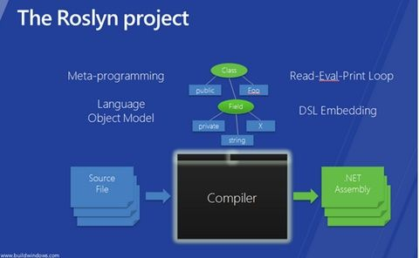
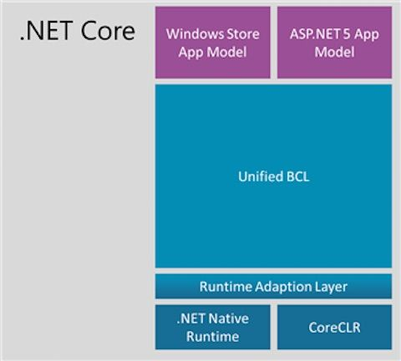

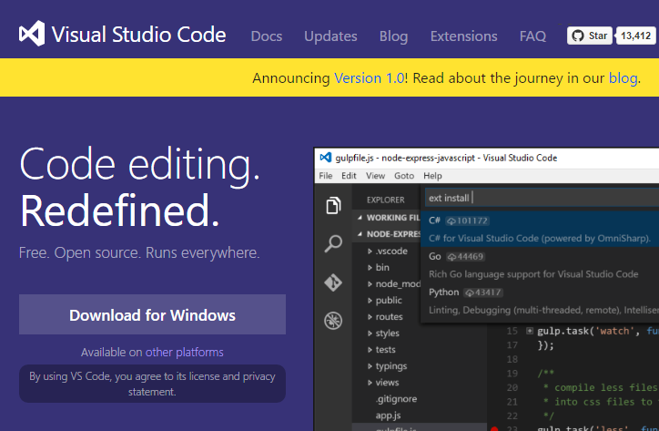
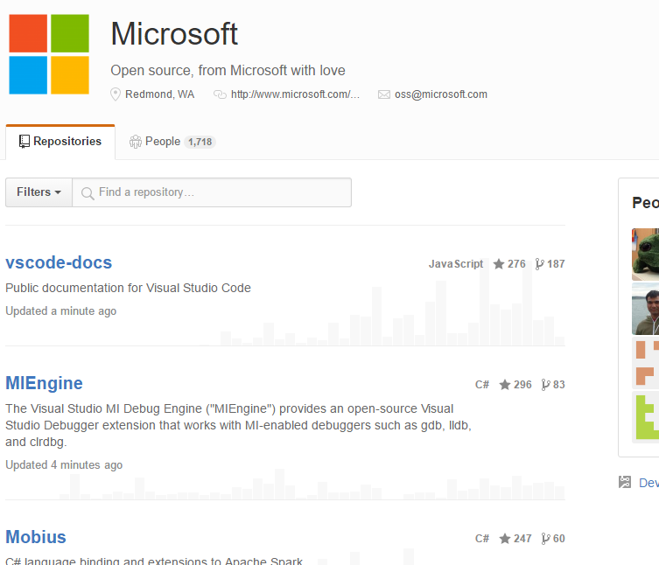

Slide 13
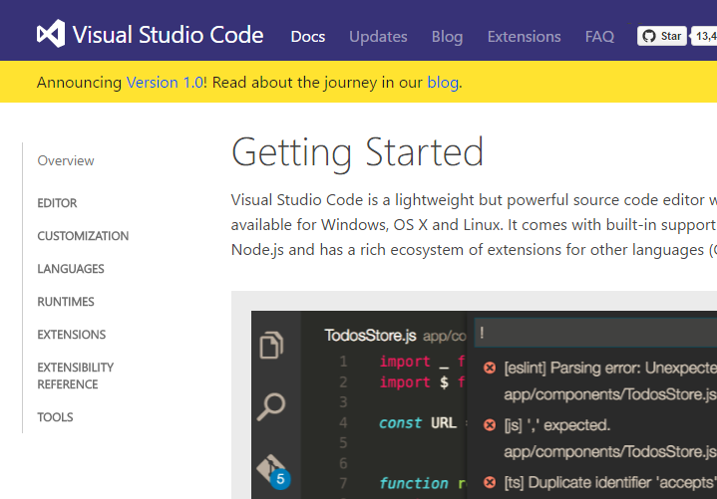
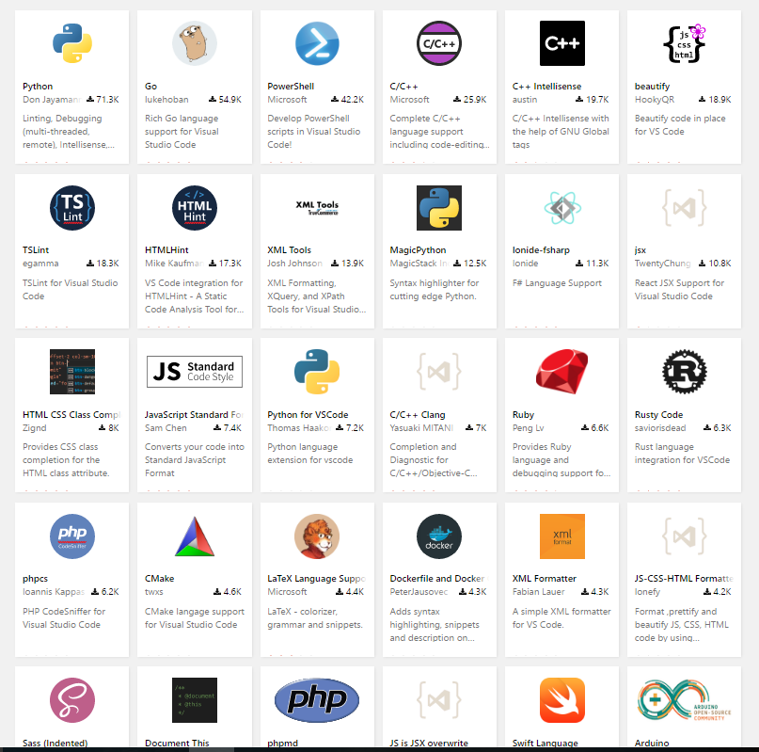


Slide 14
Microsoft ♥ Python

Slide 15




Microsoft Cognitive Services
Cognitive Services
IoT Service
SQL Database
Machine Learning
Machine Learning
Stream Analytics
Power BI
Sensors on
Linux (Rasberian)
IoT Hubs
Blob / Table

Slide 16
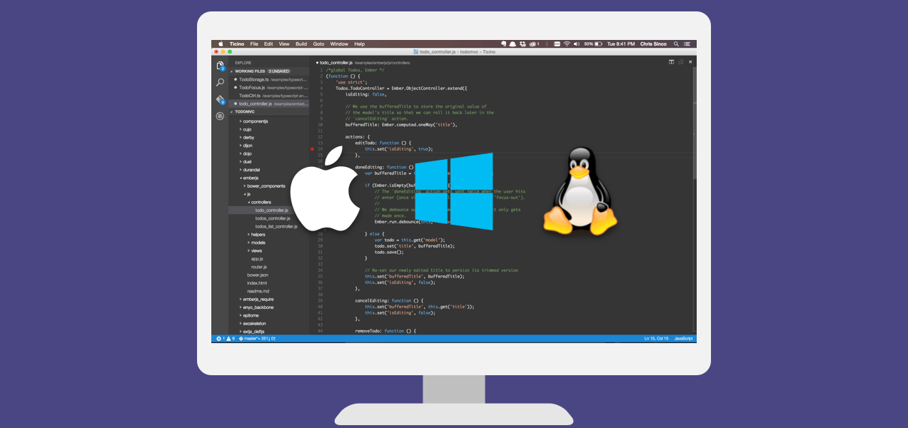
Visual Studio Code

Slide 17
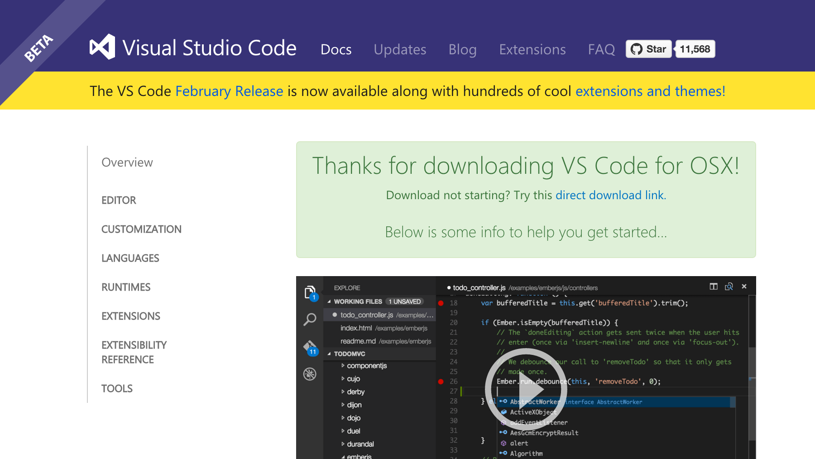
http://visualstudio.com

Slide 18
http://www.Microsoft.com/cognitive
Cognitive Service

Slide 19

Cognitive Services
Vision
From faces to feelings, allow your apps to understand images and video
Microsoft Cognitive Services
Give your apps a human side
Speech
Hear and speak to your users by filtering noise, identifying speakers, and understanding intent
Language
Process text and learn how to recognize what users want
Knowledge
Tap into rich knowledge amassed from the web, academia, or your own data
Search
Access billions of web pages, images, videos, and news with the power of Bing APIs

Slide 20
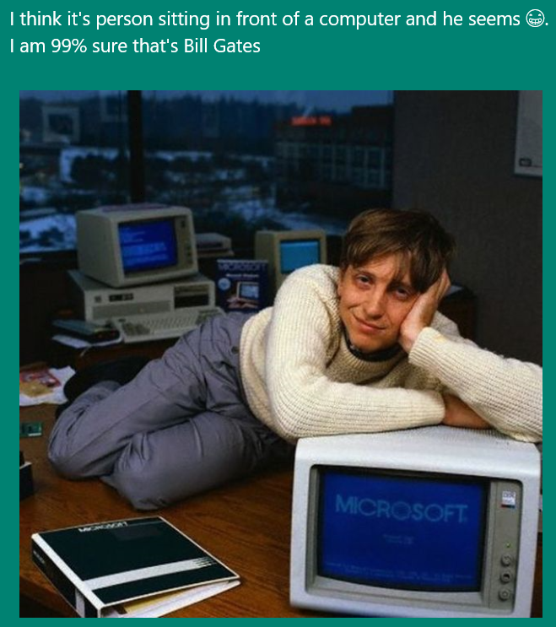
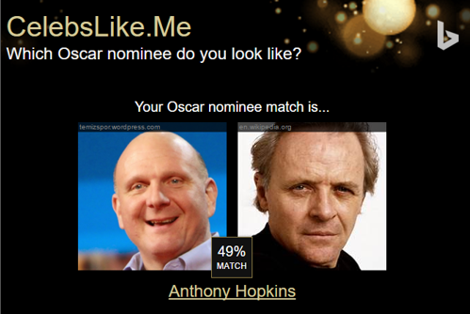

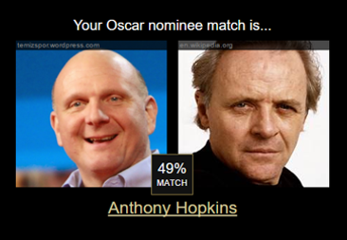
Apps Powered by MS Cognitive Services
I think it’s a person sitting in front of a computer and he seems ☺. I am 99% sure that’s Bill Gates
CaptionBot.ai
Celebslike.me
ProjectMurphy.net

Slide 21







Why Microsoft Cognitive Services ?
Easy
Flexible
Tested
Roll your own with REST APIs
Simple to add: just a few lines of code required
Make the same API code call on iOS, Android, and Windows
Integrate into the language and platform of your choice
Built by experts in their field from Microsoft Research, Bing, and Azure Machine Learning
Quality documentation, sample code, and community support
GET A KEY
BUILD

Slide 22

Cognitive Services
microsoft.com/cognitive
Vision
Speech
Language
Knowledge
Search
Computer Vision
Custom Recognition
Bing Spell Check
Academic Knowledge
Bing
Web Search
Emotion
Speaker Recognition
Linguistic Analysis
Entity Linking
Bing
Image Search
Face
Speech
Language Understanding
Knowledge Exploration
Bing
Video Search
Video
Translator
Text Analytics
Recommendations
Bing
News Search
WebLM
Bing
Autosuggest

Slide 23
Cognitive Services
microsoft.com/cognitive
Vision
Speech
Language
Knowledge
Search
Computer Vision
Custom Recognition
Bing Spell Check
Academic Knowledge
Bing
Web Search
Emotion
Speaker Recognition
Linguistic Analysis
Entity Linking
Bing
Image Search
Face
Speech
Language Understanding
Knowledge Exploration
Bing
Video Search
Video
Translator
Text Analytics
Recommendations
Bing
News Search
WebLM
Bing
Autosuggest

Slide 24
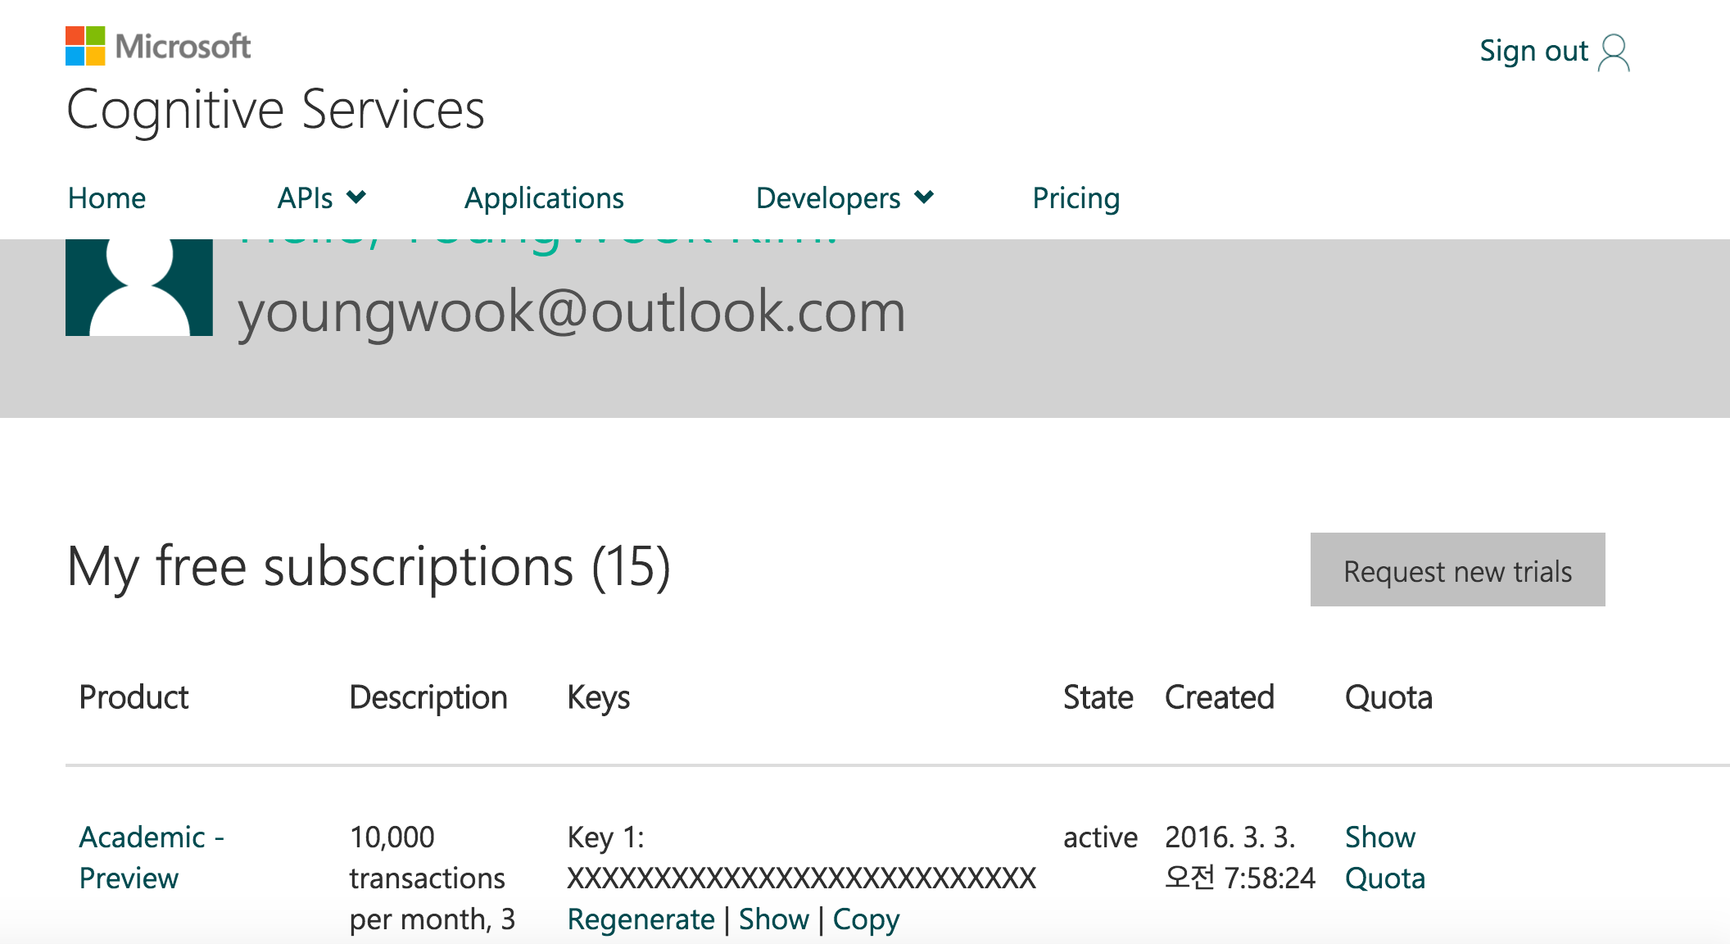
{Subscription Key}

Slide 25
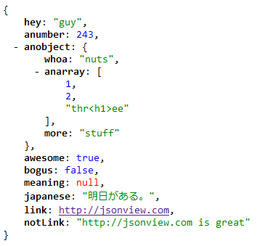

JSON
http://www.json.org/json-ko.html

Slide 26
Vision API Computer Vision Emotion Face

Slide 27
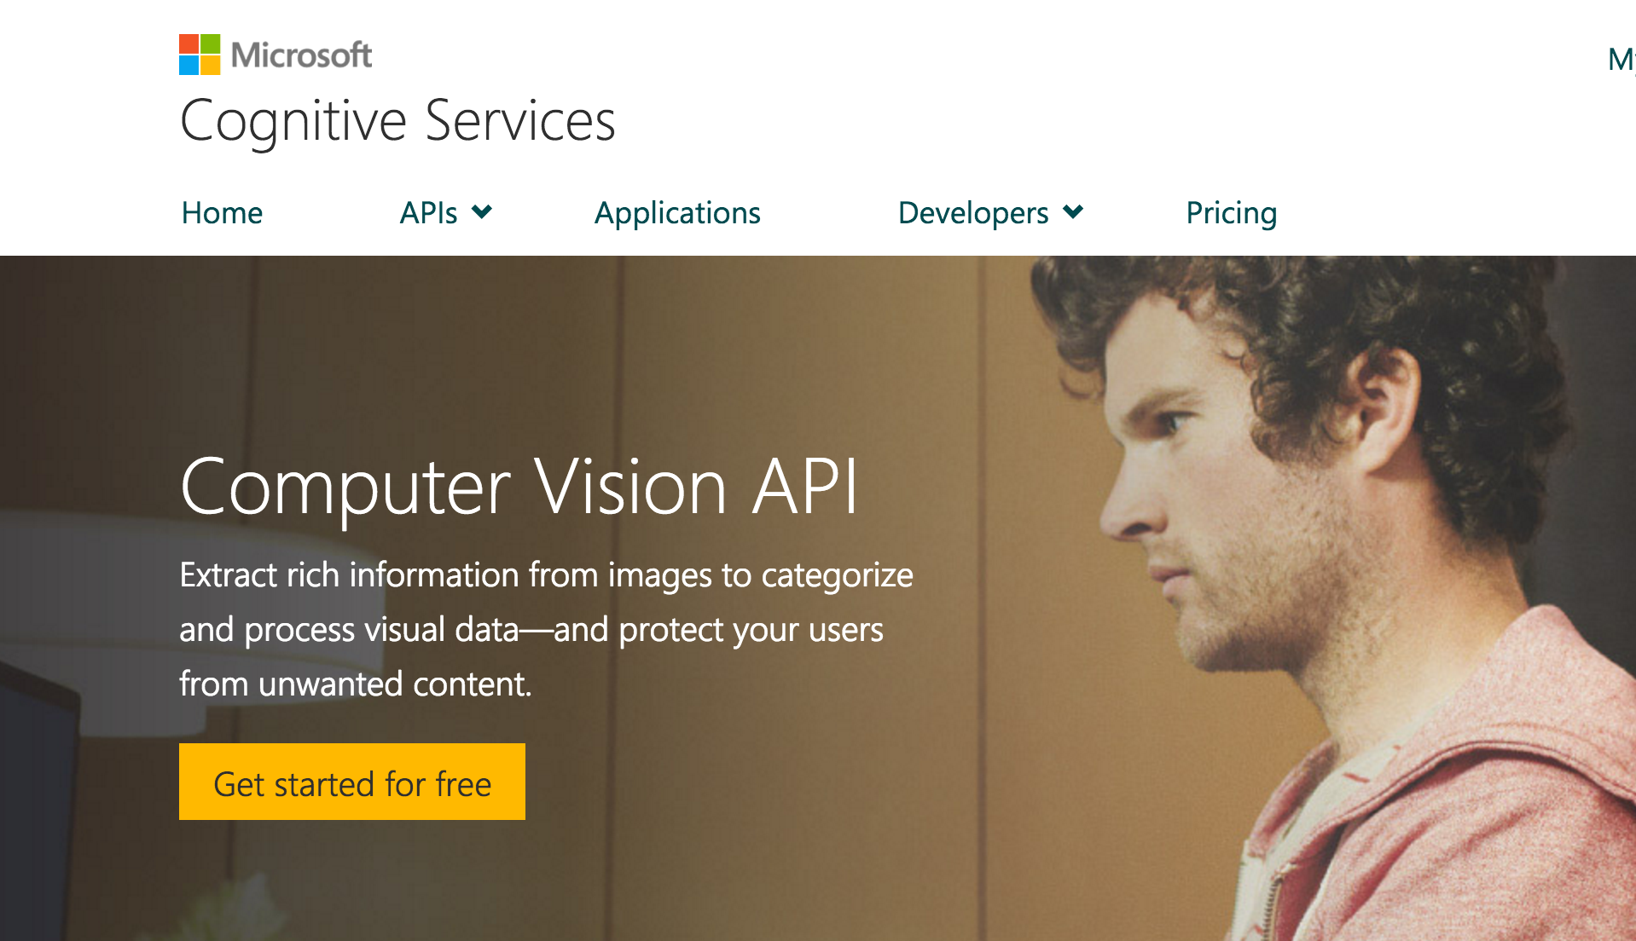

Slide 28
Demo

Slide 29
Language Bing Spell check Language Understanding Linguistic Analysis Text Analytics WebLM

Slide 30
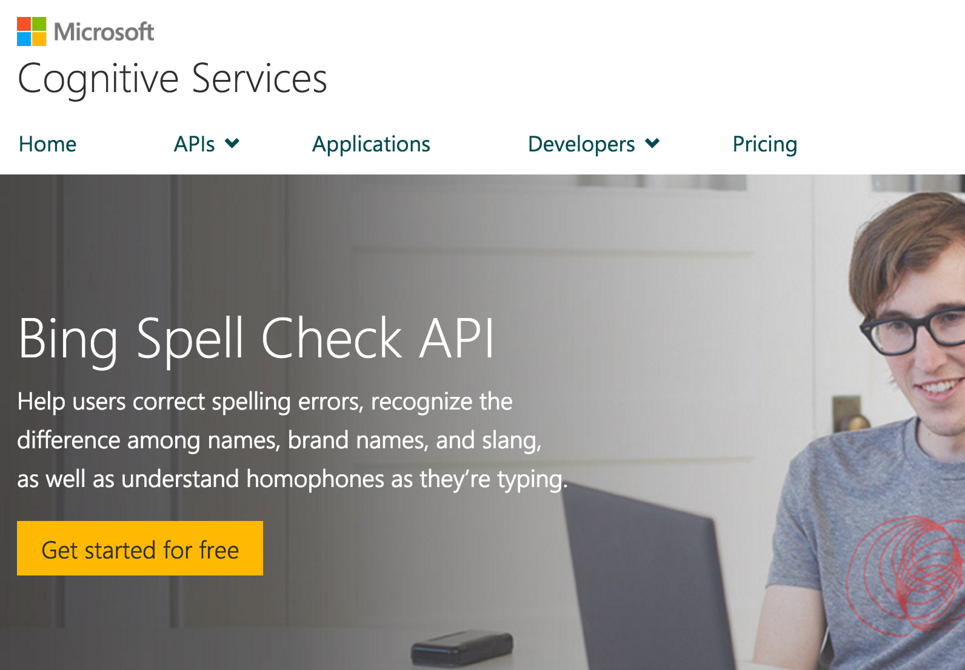

Slide 31
Demo

Slide 32
Bing Bing Web Search Bing Image Search Bing Video Search Bing News Search Bing Autosuggest

Slide 33













Bing beyond search in bing.com
Smarter, more engaging experiences
Trusted by industry-leading experiences
apple

Slide 34








Introducing Bing Search API v5
Search API v5
Web Search
Enhanced Search and Filtering Capabilities
Image Search
Web-
Scale
Secure (HTTPs)
High Performance
Video Search
News Search
REST
Autosuggest
Ongoing Improvements and Support
Spell Check

Slide 35
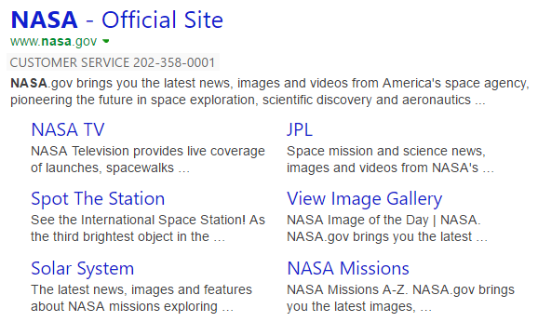

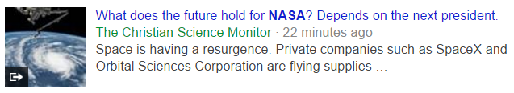

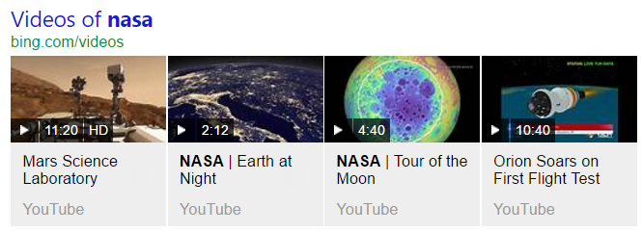
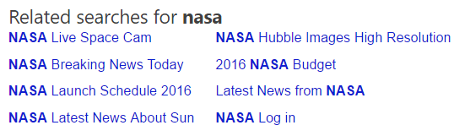
Web Search API
Web Search API
Get relevant web and answer results and metadata with one API call
https://bingapis.azure-api.net/v5/search?q=nasa
Web
Results
Search Response
Deep Links
(1st Algo)
{
“_type”: “SearchResponse”,
“queryContent”: {…},
“webPages”: {…},
“news”: {…},
“images”: {…},
“videos”: {…},
“relatedSearches”: {…},
“rankingResponse”: {…}
}
News Results
Ranking Response
Image
Results
{
“answerType”:”WebPages”,
“resultIndex”:0,…
},
{
“answerType”:”News”,
“resultIndex”:1,…
}
Video Results
Related Searches
*screenshots show actual search results on bing.com

Slide 36
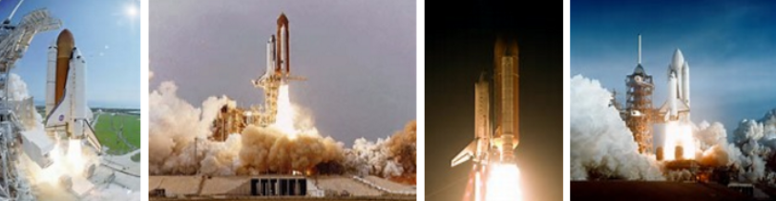


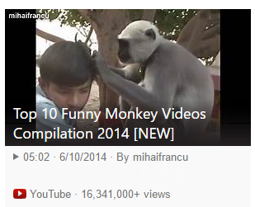
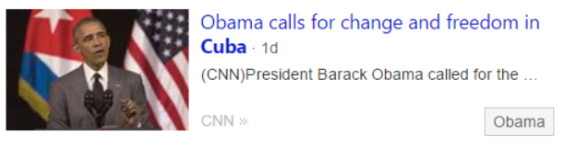
Vertical Search APIs
Get more results, features and metadata tailored to each search vertical
Image Search API
https://bingapis.azure-api.net/v5/images/search?q=shuttle+launch
Enhanced metadata and filters (size, license, style, freshness, color)
Image insights (entity recognition, visually similar)
source: nasa.gov
Video Search API
https://bingapis.azure-api.net/v5/videos/search?q=viral+videos
Enhanced metadata and filters (price, resolution, length, freshness)
Motion thumbnails (video preview)
source: youtube.com
News Search API
https://bingapis.azure-api.net/v5/news/search?q=cuba
News by category/market, and trending news
Rich article metadata (featured entities)
source: cnn.com
*screenshots show actual search results in bing.com

Slide 37
Demo

Slide 38
Developer Call to Action
Sign up and get started today for free at www.microsoft.com/cognitive

Slide 39
http://www.microsoft.com/iot
Internet of Things

Slide 40
Microsoft Cognitive Services
Cognitive Services
IoT Service
SQL Database
Machine Learning
Machine Learning
Stream Analytics
Power BI
Sensors on
Linux (Rasberian)
IoT Hubs
Blob / Table

Slide 41
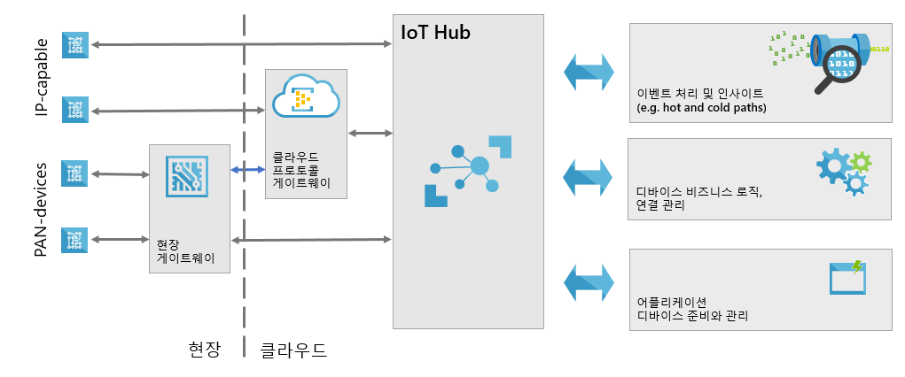
IoT Hub
지원되는 프로토콜은 HTTP1.1, MQTT, AMQP 1.0 (16년 4월 OPC 공식지원 발표)
LWM2M, CoAP 등의 지원은 계획 중이나 시기 미정

Slide 42
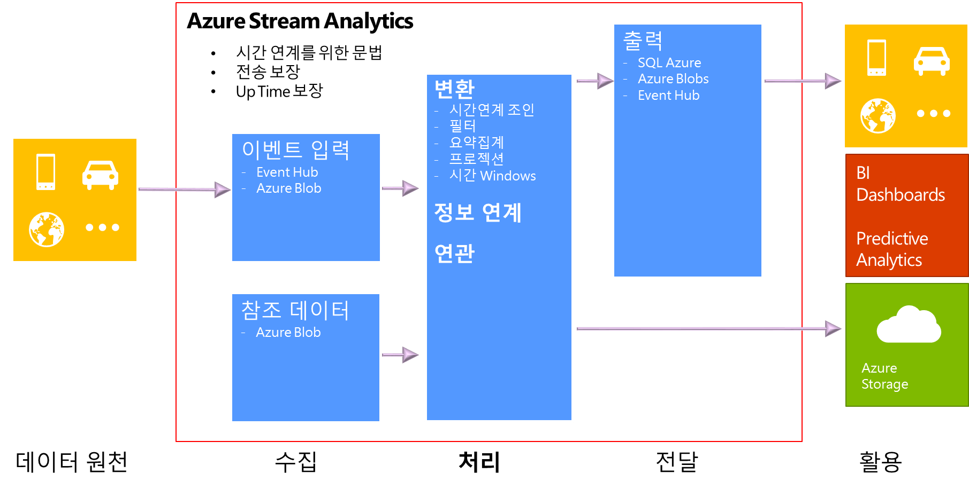
Stream Analysis

Slide 43
Microsoft Cognitive Services
Cognitive Services
IoT Service
SQL Database
Machine Learning
Machine Learning
Stream Analytics
Power BI
Sensors on
Linux (Rasberian)
IoT Hubs
Blob / Table

Slide 44
http://www.microsoft.com/iot
Machine Learning

Slide 45


Slide 46

Microsoft & Machine Learning 15 years of realizing innovation
1999
2004
2005
2008
2010
2012
2014
Computers work on users behalf, filtering junk email
Microsoft search engine built with machine learning
SQL Server enables data mining
Bing Maps ships with ML traffic-prediction service
Microsoft Kinect can watch users gestures
Successful, real-time, speech-to-speech translation
Microsoft launches Azure Machine Learning
Machine learning is pervasive throughout Microsoft products.
“
John Platt, Distinguished scientist at Microsoft Research
”

Slide 47

One solution for Machine Learning - from data to results
Web Apps
Mobile Apps
PowerBI/Dashboards
ML API service
Developer
Azure Portal
ML Studio
Azure Portal & ML API service
HDInsight
Azure Storage
Azure Ops Team
Azure Ops Team
Data Scientist
Desktop Data

Slide 48
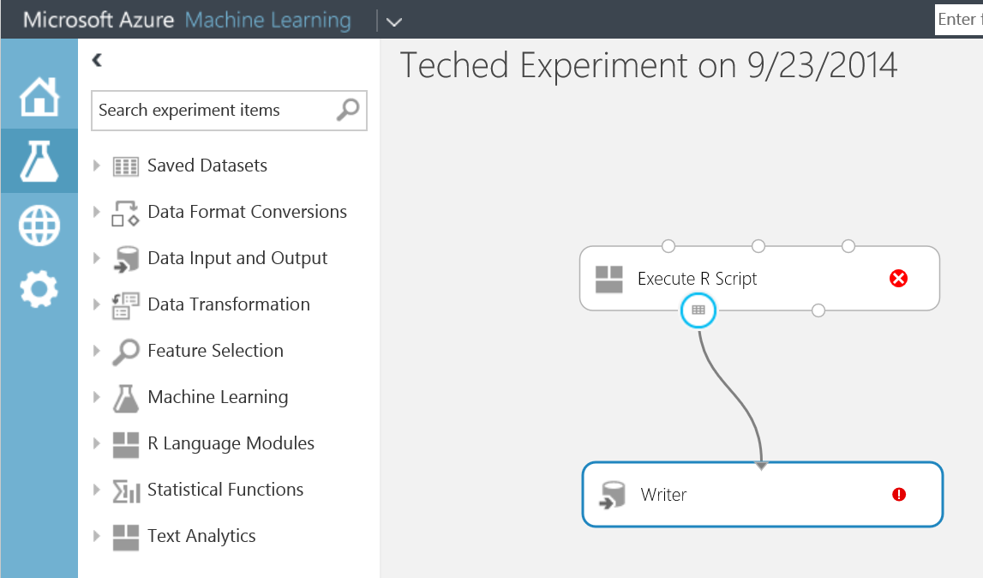
Machine Learning
Data I/O
Taking Data & preparing for Analysis
Dimensionality reduction. E.g. Kinect measures 1000 points, 6 are relevant
Fitting Model selection; calibration; assessment
R – free scripts/graphics, many packages based on Vector Data.
Metrics to allow us to describe the data. E.g. Mean, Correlation…
Tools used for Text Input. E.g. ‘What is the theme of this essay?’

Slide 49


